Slide 1
COMP3074 Mobile App Development I
Week 4

Slide 2
Storage Options
Android provides several options for you to save persistent application data. The solution you choose depends on your specific needs, such as whether the data should be private to your application or accessible to other applications (and the user) and how much space your data requires.
Shared Preferences
Store private primitive data in key-value pairs.
Internal Storage
Store private data on the device memory.
External Storage
Store public data on the shared external storage.

Slide 3
Storage Options
SQLite Databases
Store structured data in a private database.
Network Connection
Store data on the web with your own network server.
Android provides a way for you to expose even your private data to other applications — with a content provider. A content provider is an optional component that exposes read/write access to your application data, subject to whatever restrictions you want to impose.

Slide 4
Working with Transactions
You can use SQL Transactions to group operations together; if any of the operations fails, you can handle the error and either recover or roll back all operations.
If the operations all succeed, you can then commit them. Here we have the basic structure for a transaction:
mDatabase.beginTransaction();
try {
// Insert some records, updated others, delete a few
// Do whatever you need to do as a unit, then commit it
mDatabase.setTransactionSuccessful();
} catch (Exception e) {
// Transaction failed. Failed! Do something here.
// It’s up to you.
} finally {
mDatabase.endTransaction();
}

Slide 5
Working with Cursors
Use a Cursor to access the results returned from a SQL query
Cursor class is in android.database package
Think of query results as a table, in which each row corresponds to a returned record.
A Cursor object is similar to a file pointer; it allows random access to query results.
The Cursor object includes helpful methods for determining how many results were returned by the query the Cursor represents and methods for determining the column names (fields) for each returned record.

Slide 6
Working with Cursors
The columns in the query results are defined by the query, not necessarily by the database columns.
These might include calculated columns, column aliases, and composite columns.
Cursor cursor = sqLiteDatabase.query(tableName, tableColumns, whereClause, whereArgs, groupBy, having, orderBy);
tableColumns - columns parameter is constructed as follows.
String[] columns = new String[]{KEY_ID, KEY_CONTENT};

Slide 7
Working with Cursors
Cursor cursor = sqLiteDatabase.query(tableName, tableColumns, whereClause, whereArgs, groupBy, having, orderBy);
tableColumns
null for all columns as in SELECT * FROM ...
new String[] { "column1", "column2", ... } for specific columns as in SELECT column1, column2 FROM ... - you can also put complex expressions here:
new String[] { "(SELECT max(column1) FROM table1) AS max" } would give you a column named max holding the max value of column1

Slide 8
Working with Cursors
Cursor cursor = sqLiteDatabase.query(tableName, tableColumns, whereClause, whereArgs, groupBy, having, orderBy);
whereClause
the part you put after WHERE without that keyword, e.g. "column1 > 5"
should include ? for things that are dynamic, e.g. "column1=?" -> see whereArgs
whereArgs
specify the content that fills each ? in whereClause in the order they appear.
just like whereClause the statement after the keyword or null if you don't use it.

Slide 9
Working with Cursors
String[] tableColumns = new String[] {
"column1",
"(SELECT max(column1) FROM table1) AS max"
};
String whereClause = "column1 = ? OR column1 = ?";
String[] whereArgs = new String[] {
"value1",
"value2"
};
String orderBy = "column1";
Cursor c = sqLiteDatabase.query("table1", tableColumns, whereClause, whereArgs, null, null, orderBy);

Slide 10
Working with Cursors
Previous example is similar to SQL statement below:
String queryString =
"SELECT column1, (SELECT max(column1) FROM table1) AS max FROM table1 " +
"WHERE column1 = ? OR column1 = ? ORDER BY column1";
sqLiteDatabase.rawQuery(queryString, whereArgs);

Slide 11
query() Example
query(String table, String[] columns, String selection, String[] selectionArgs, String groupBy, String having, String orderBy, String limit)
Query the given table, returning a Cursor over the result set.
http://developer.android.com/reference/android/database/sqlite/SQLiteDatabase.html

Slide 12
Table: Parameters of the query() method
Parameter | Comment
String tbName | The table name to compile the query against.
String[] columnNames | A list of which table columns to return. Passing "null" will return all columns.
String whereClause | Where-clause, i.e. filter for the selection of data, null will select all data.
String[] selectionArgs | You may include ?s in the "whereClause"". These placeholders will get replaced by the values from the selectionArgs array.
String[] groupBy | A filter declaring how to group rows, null will cause the rows to not be grouped.
String[] having | Filter for the groups, null means no filter.
String[] orderBy | Table columns which will be used to order the data, null means no ordering.

Slide 13
Managing Cursors as Part of the Application Lifecycle
Cursor objects must be managed as part of the application lifecycle.
When the application pauses or shuts down, the Cursor must be deactivated with a call to the deactivate() method
When the application restarts, the Cursor should refresh its data using the requery() method.
When the Cursor is no longer needed, a call to close() must be made to release its resources.
Handle this by implementing Cursor management calls within the various lifecycle callbacks, such as onPause(), onResume(), and onDestroy().

Slide 14
Managing Cursors as Part of the Application Lifecycle
You can hand off the responsibility of managing Cursor objects to the parent Activity by using the Activity method called startManagingCursor().
The Activity handles the rest, deactivating and reactivating the Cursor as necessary and destroying the Cursor when the Activity is destroyed.
You can always begin manually managing the Cursor object again later by simply calling stopManagingCursor().

Slide 15
Managing Cursors as Part of the Application Lifecycle
Here we perform the same simple query and then hand over Cursor management to the parent Activity:
// SIMPLE QUERY: select * from tbl_books
Cursor c = mDatabase.query(“tbl_books”,null,null,null,null,null,null);
startManagingCursor(c);

Slide 16
Navigating Query Results
You can use the Cursor to iterate query results, one row at a time using various navigation methods such as moveToFirst(), moveToNext(), and isAfterLast().
On a specific row, you can use the Cursor to extract the data for a given column in the query results.
Because SQLite is not strongly typed, you can always pull fields out as Strings using the getString() method, but you can also use the type-appropriate extraction utility function to enforce type safety in your application.

Slide 17
Navigating Query Results
The following method takes a valid Cursor object, prints the number of returned results, some column information (name and number of columns):
public void logCursorInfo(Cursor c) {
Log.i(DEBUG_TAG, “*** Cursor Begin *** “ + “ Results:” +
c.getCount() + “ Columns: “ + c.getColumnCount());
// Print column names
String rowHeaders = “|| “;
for (int i = 0; i < c.getColumnCount(); i++) {
rowHeaders = rowHeaders.concat(c.getColumnName(i) + “ || “);
}

Slide 18
Navigating Query Results
Next, iterates over query results:
Log.i(DEBUG_TAG, “COLUMNS “ + rowHeaders);
// Print records
c.moveToFirst();
while (c.isAfterLast() == false) {
String rowResults = “|| “;
for (int i = 0; i < c.getColumnCount(); i++) {
rowResults = rowResults.concat(c.getString(i) + “ || “);
}
Log.i(DEBUG_TAG,
“Row “ + c.getPosition() + “: “ + rowResults);
c.moveToNext();
}
Log.i(DEBUG_TAG, “*** Cursor End ***”);
}

Slide 19
Executing Simple Queries
If you need only the titles of each book in the book table, you might use the call to the query() method:
String asColumnsToReturn[] = { “title”, “id” };
String strSortOrder = “title ASC”;
Cursor c = mDatabase.query(“tbl_books”, asColumnsToReturn,
null, null, null, null, strSortOrder);
This is equivalent to the SQL query
SELECT title, id FROM tbl_books ORDER BY title ASC;

Slide 20
Executing More Complex Queries Using SQLiteQueryBuilder
SQLiteQueryBuilder is a convenience class, which can build complex queries (such as joins) programmatically:
SQLiteQueryBuilder queryBuilder = new SQLiteQueryBuilder();
queryBuilder.setTables(“tbl_books, tbl_authors”);
queryBuilder.appendWhere(“tbl_books.authorid=tbl_authors.id”);
String asColumnsToReturn[] = {
“tbl_books.title”,
“tbl_books.id”,
“tbl_authors.firstname”,
“tbl_authors.lastname”,
“tbl_books.authorid” };
String strSortOrder = “title ASC”;
Cursor c = queryBuilder.query(mDatabase, asColumnsToReturn,
null, null, null, null,strSortOrder);

Slide 21
Android Listview Example using CursorAdapter and SQLite database
The objective is to get data from SQLite database by extending the SimpleCursorAdapter and then attach that to the Listview.
In this example we create a database of countries and then insert some countries when the activity starts.
After that we create a SimpleCursorAdapter and attach that to cursor returned from our database custom query selection.
The data columns returned from the cursor is then mapped to our custom view for display.
Notes:
Get ListViewCursorAdaptor from Week 8

Slide 22
Deleting Tables and Other SQLite Objects
Format the appropriate SQLite statements and execute them.
For example, to drop our tables and triggers, we can execute three SQL statements:
Database.execSQL(“DROP TABLE tbl_books;”);
Database.execSQL(“DROP TABLE tbl_authors;”);
Database.execSQL(“DROP TRIGGER IF EXISTS fk_insert_book;”);
Closing a SQLite Database
You should close your database when you are not using: mDatabase.close();

Slide 23
Deleting a SQLite Database
The simplest way to delete a SQLiteDatabase is to use the deleteDatabase() method of your application Context.
You delete databases by name and the deletion is permanent.
You lose all data and schema information.
deleteDatabase(“my_sqlite_database.db”);

Slide 24
Designing Persistent Databases
The Android SDK provides a helper class called SQLiteOpenHelper to help you manage your application’s database.
To create a SQLite database for your Android application using the SQLiteOpenHelper, you need to extend that class and then instantiate an instance of it as a member variable for use within your application.

Slide 25
Android Database Tutorial
http://www.androidhive.info/2011/11/android-sqlite-database-tutorial/

Slide 26
References
Textbook
Android Documentation

Slide 27
Working with Files and Directories
Android application data is stored on the Android file system in the following top-level directory:
/data/data/<package name>/
Several default subdirectories are created for storing databases, preferences, and files as necessary.
You can also create other custom directories as needed.
File operators all begin by interacting with the application Context
You can use all the standard java.io package utilities to work with FileStream objects.

Slide 28
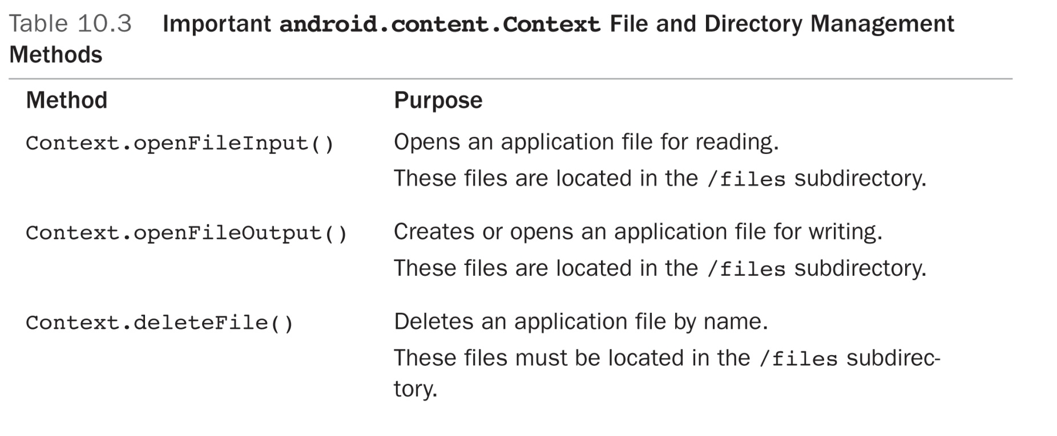
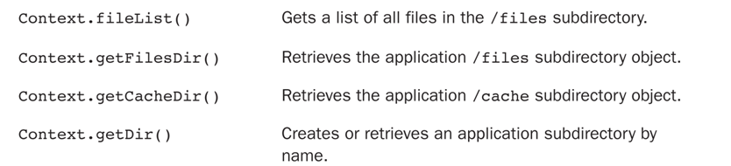
Working with Files and Directories

Slide 29
Creating and Writing to Files to the Default Application Directory
Android applications that require only the occasional file rely upon the helpful method called openFileOutput().
Use this method to create files in the default location under the application data directory:
/data/data/<package name>/files/
For example, the following code snippet creates and opens a file called Filename.txt.
We write a single line of text to the file and then close the file:
FileOutputStream fos;
String strFileContents = “Some text to write to the file.”;
fos = openFileOutput(“Filename.txt”, MODE_PRIVATE);
fos.write(strFileContents.getBytes());
fos.close();

Slide 30
Creating and Writing to Files to the Default Application Directory
We can append data to the file by opening it with the mode set to MODE_APPEND:
FileOutputStream fos;
String strFileContents = “More text to write to the file.”;
fos = openFileOutput(“Filename.txt”, MODE_APPEND);
fos.write(strFileContents.getBytes());
fos.close();
The file we created has the following path on the Android file system:
/data/data/<package name>/files/Filename.txt

Slide 31
Reading from Files in the Default Application Directory
We have a shortcut for reading files stored in the default /files subdirectory.
The following code snippet opens a file called Filename.txt for read operations:
String strFileName = “Filename.txt”;
FileInputStream fis = openFileInput(strFileName);

Slide 32
Reading Raw Files Byte-by-Byte
You handle file I/O operations using standard Java methods.
Subclasses of java.io.InputStream are used for reading bytes from different types of primitive file types.
For example, DataInputStream is useful for reading one line at a time.
Here’s a simple example of how to read a text file, line by line, and store it in a StringBuffer:
FileInputStream fis = openFileInput(filename);
StringBuffer sBuffer = new StringBuffer();
DataInputStream dataIO = new DataInputStream(fis);
String strLine = null;
while ((strLine = dataIO.readLine()) != null) {
sBuffer.append(strLine + “\n”);
}
dataIO.close();
fis.close();

Slide 33
Working with Other Directories and Files on the Android File System
To manage your files the Android file system uses the standard java.io.File class methods.
The following code gets a File object for the /files application subdirectory and retrieves a list of all filenames in that directory:
File pathForAppFiles = getFilesDir();
String[] fileList = pathForAppFiles.list();

Slide 34
Working with Other Directories and Files on the Android File System
WriteTextIntoFile Example
Get the file WriteTextIntoFile, from Week 8 and run it.
Let’s see whether the file created internally!
Click on Save button, would it cause for lines to be appended to the file ?
Gray out Retrieve button if file doesn’t exit.
Let’s read the content we wrote and display into TextView.
Allow content to be appended!
Make the view scrollable.
WriteTextIntoFile3.

Slide 35
Cache files
You can create a cache file to cache some data to speed up your application’s performance.
There is also a special application directory for storing cache files.
Cache files are stored in the following location on the Android file system:
/data/data/<package name>/cache/
You should use getCacheDir() to open a File that represents the internal directory where your application should save temporary cache files.
When the device is low on internal storage space, Android may delete these cache files to recover space.

Slide 36
Cache files
The following code gets a File object for the /cache application subdirectory, creates a new file in that specific directory, writes some data to the file, closes the file, and then deletes it:
File pathCacheDir = getCacheDir();
String strCacheFileName = “myCacheFile.cache”;
String strFileContents = “Some data for our file”;
File newCacheFile = new File(pathCacheDir, strCacheFileName);
newCacheFile.createNewFile();
FileOutputStream foCache =
new FileOutputStream(newCacheFile.getAbsolutePath());
foCache.write(strFileContents.getBytes());
foCache.close();
newCacheFile.delete();

Slide 37
Network Connection
You can use the network (when it's available) to store and retrieve data on your own web-based services. To do network operations, use classes in the following packages:
java.net.*
android.net.*

Slide 38
Content Provider
Content providers manage access to a structured set of data. They encapsulate the data, and provide mechanisms for defining data security. Content providers are the standard interface that connects data in one process with code running in another process.
Will cover in more details in coming weeks.

Slide 39
References
Textbook
Android Documentation: http://developer.android.com/guide/topics/data/data-storage.html, http://developer.android.com/guide/topics/ui/settings.html, http://developer.android.com/training/basics/data-storage/databases.html

